Slide 1
ESSENTRA
agentic rag Chatbot with model context protocol
Task Title Task Title: Agentic RAG Chatbot for Multi-Format Document QA using Model Context Protocol
GitHub Link : https://github.com/TirumalaManav/essentra-ai
Built by: TIRUMALA MANAV
👤 Manav Tirumala
📧 Email: thirumalamanav123@gmail.com
🔗 LinkedIn: linkedin.com/in/tirumalamanav
🐙 GitHub: github.com/TirumalaManav

Slide 2
Coding Task and Solution
THE CHALLENGE
• Organizations struggle with document intelligence across multiple formats
• Traditional Chatbots lack structured agent communication
• No standardized protocol for inter-agent messaging
• Limited scalability and production readiness
THE SOLUTION: ESSENTRA
✅ 5 Specialized Agents with MCP Protocol
✅ Multi-Format Document Processing (PDF, DOCX, PPTX, CSV, TXT, MD)
✅ LangGraph Workflow Orchestration
✅ Production-Ready Architecture with Chroma DB Vector Storage

Slide 3
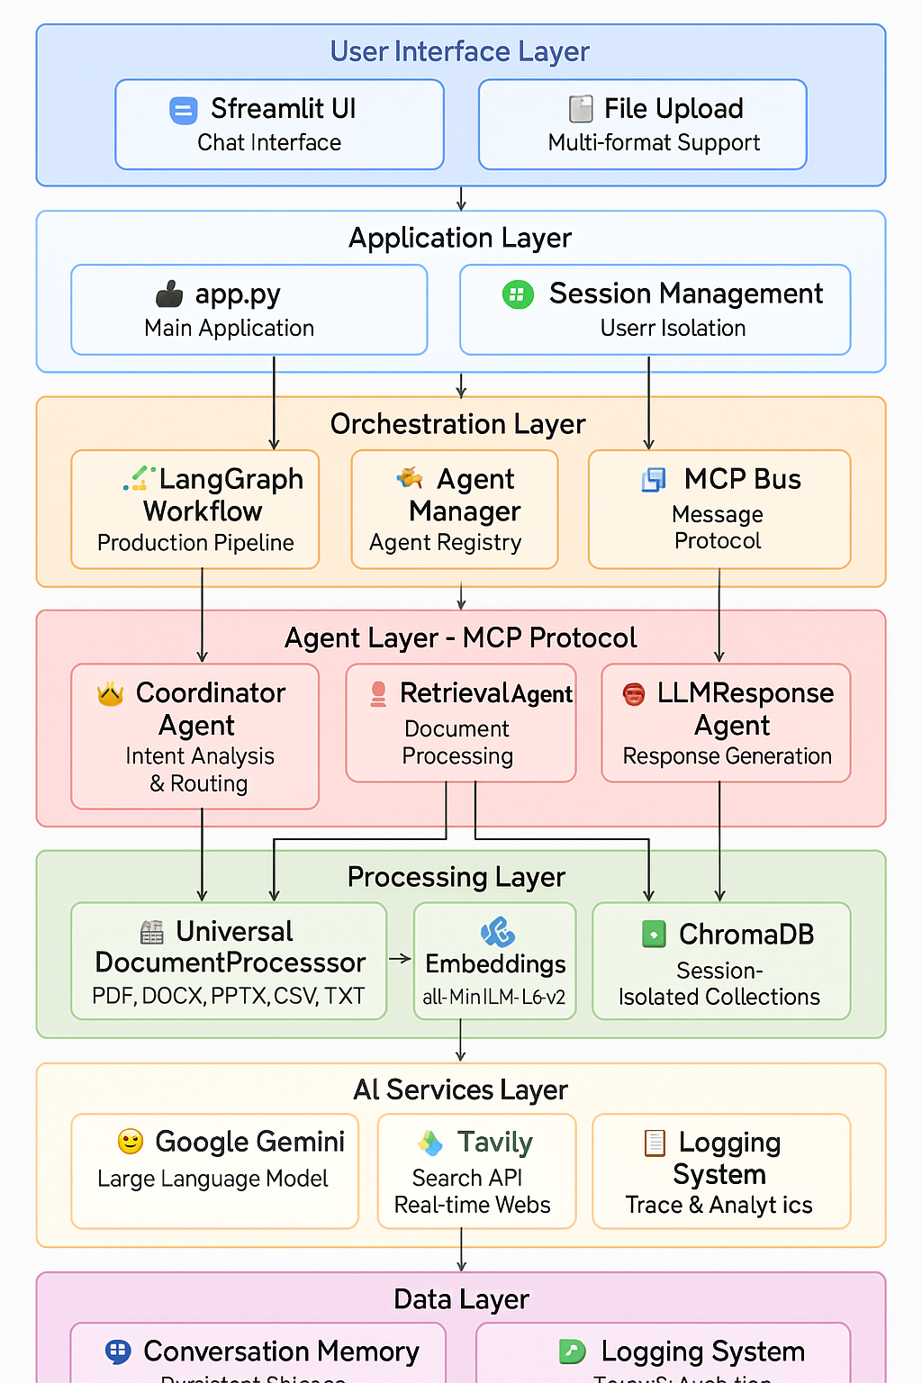
System Architecture Overview
LAYERED ARCHITECTURE:
User Interface Layer: Streamlit UI + File Upload
Application Layer: Main App + Configuration + Session Management
Orchestration Layer: LangGraph Workflow + MCP Bus
Agent Layer: 5 Specialized Agents with MCP Communication
Processing Layer: Document Processor + Embeddings + Vector Store
AI Services: Google Gemini 1.5 Flash + Tavily Search API
Data Layer : Conversation Memory and Logging System
Note: The architecture diagrams above were created using Canvas and SVG code to enhance visualization and improve readability, taking the project's structure into careful consideration

Slide 4
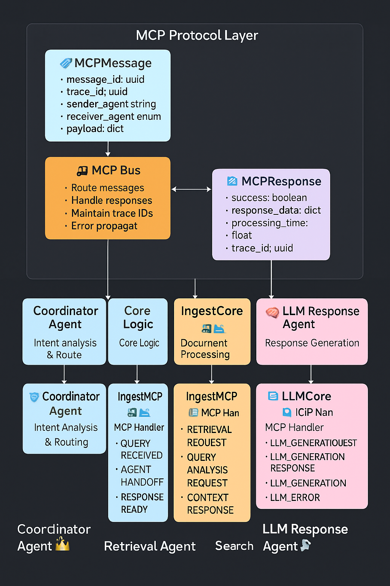
Agent Architecture and MCP Protocol
5 INTELLIGENT AGENTS:
CoordinatorAgent - Intent analysis & routing decisions
IngestionAgent - Multi-format document processing
RetrievalAgent - Semantic search & context ranking
LLMResponseAgent - Enhanced response generation
WebSearchAgent - Real-time information retrieval
MCP PROTOCOL FEATURES:
• Structured message passing with trace IDs
• Error propagation and handling
• Processing time tracking
• Response validation
Note: The architecture diagrams above were created using Canvas and SVG code to enhance visualization and improve readability, taking the project's structure into careful consideration

Slide 5
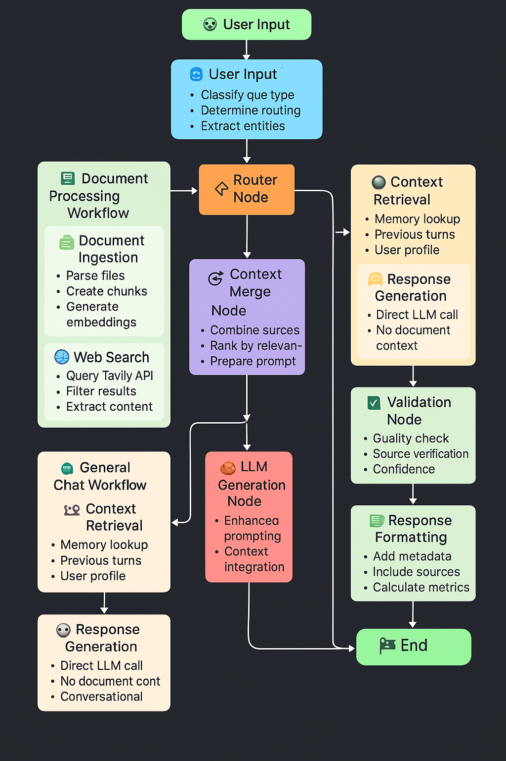
LangGraph Workflow and Message Flow
INTELLIGENT ROUTING:
• Intent Analysis Node - Classifies query type and entities
• Router Node - Determines optimal processing pathway
• Context Merge Node - Combines multiple information sources
• Validation Node - Quality assurance and confidence scoring
• Memory Update Node - Persistent conversation storage
WORKFLOW TYPES:
📄 Document Processing Workflow
🌐 Web Search Workflow
💬 General Chat Workflow
Note: The architecture diagrams above were created using Canvas and SVG code to enhance visualization and improve readability, taking the project's structure into careful consideration

Slide 6
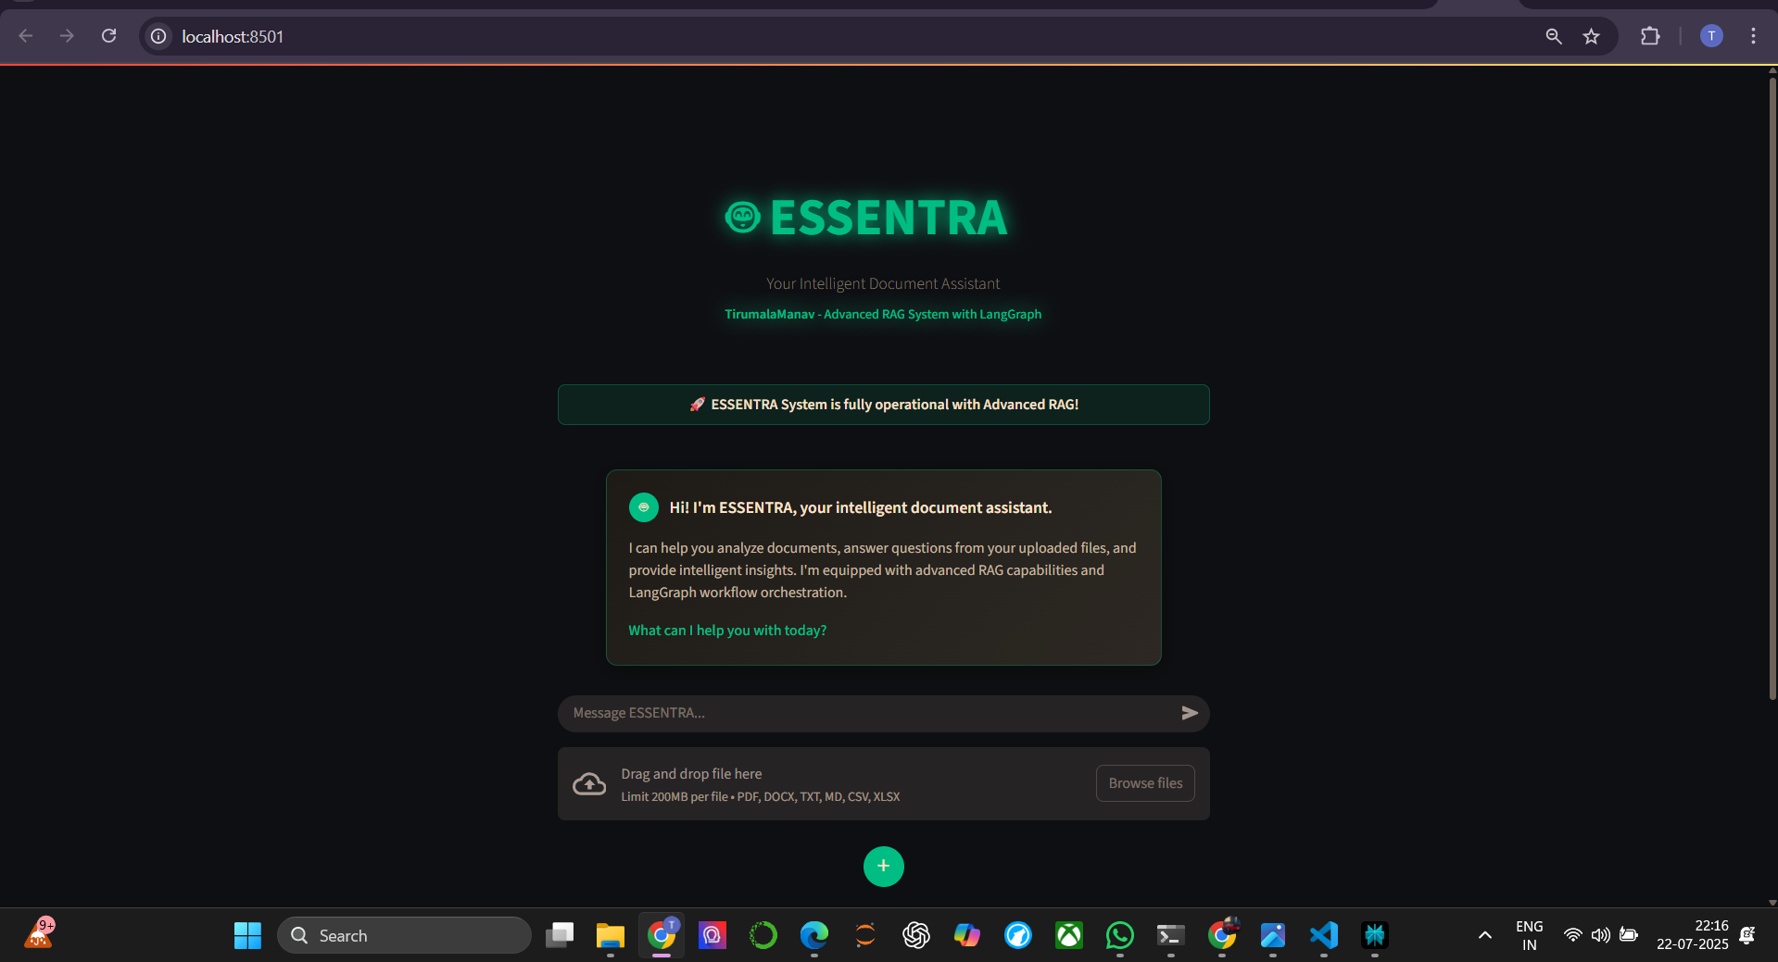
Technology Stack
CORE TECHNOLOGIES:
Frontend: Streamlit with ChatGPT-like UI
Orchestration: LangGraph Workflow Engine
Communication: Custom MCP Protocol Implementation
LLM: Google Gemini 1.5 Flash
Web Search: Tavily Search API
Vector DB: ChromaDB with Session Isolation
Embeddings: Sentence Transformers (all-MiniLM-L6-v2)
FEATURES:
Async Processing & Performance Optimization
Conversation Memory with Persistence
Session Management & User Isolation
Comprehensive Logging & Analytics
Production-Grade Error Handling

Slide 7
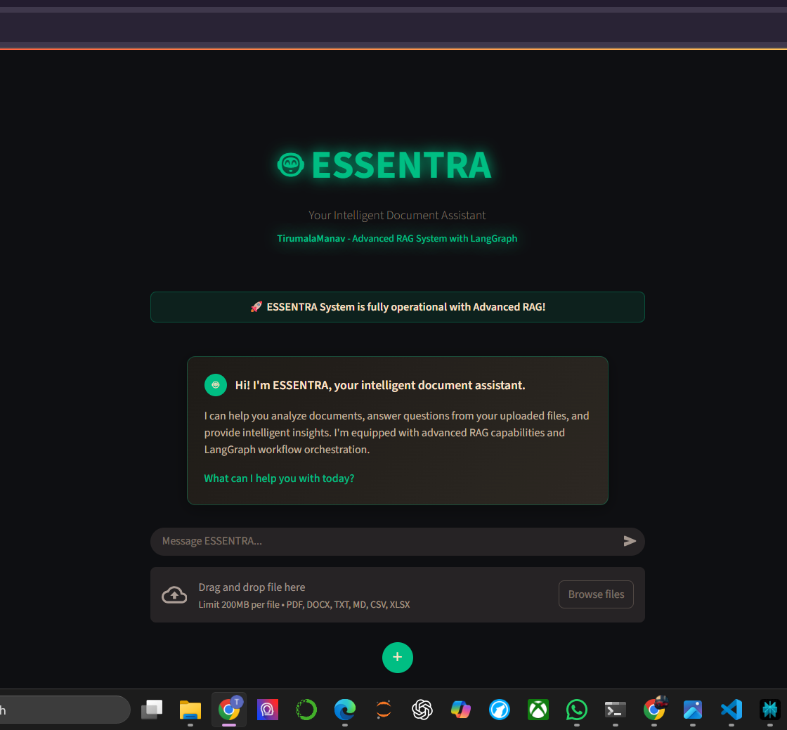
UI Screenshots and Features
KEY UI FEATURES:
Clean, Modern ChatGPT-Style Interface
Drag & Drop File Upload with Progress Indicators
Real-time Processing Feedback with Spinners
Source Attribution with Confidence Scores
Multi-turn Conversation Support
Responsive Design with Smooth Animations
USER EXPERIENCE:
Intuitive file upload for multiple formats
Instant processing feedback
Clear source citations
Professional presentation

Slide 8
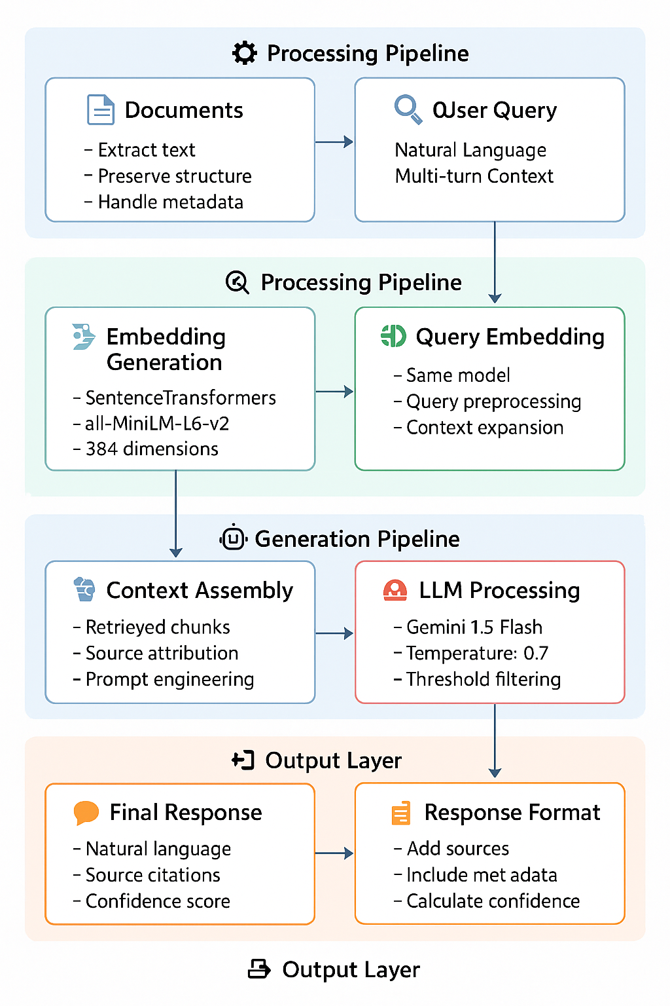
Data Processing Pipeline
Key Features
Document Parsing - Extract text while preserving structure
Smart Chunking - 500 tokens with 50 token overlap
Embedding Generation - 384-dimensional vectors
Vector Storage - Session-isolated ChromaDB collections
Semantic Retrieval - Cosine similarity with ranking
Context Assembly - Multi-source information fusion
LLM Generation - Enhanced prompting with Gemini
Response Formatting - Source citations & metadata
Note: The architecture diagrams above were created using Canvas and SVG code to enhance visualization and improve readability, taking the project's structure into careful consideration

Slide 9
Challenges Faced and Solutions
CHALLENGE 1: MCP Protocol Implementation
❌ Problem: Complex inter-agent communication with trace IDs
✅ Solution: Custom MCPBus with async message routing
CHALLENGE 2: Multi-Format Document Processing
❌ Problem: Different parsing strategies for each format
✅ Solution: UniversalDocumentProcessor with format handlers
CHALLENGE 3: Session Isolation for Multiple Users
❌ Problem: Shared vector storage causing data leaks
✅ Solution: Session-specific ChromaDB collections
CHALLENGE 4: Real-time Performance Optimization
❌ Problem: Large document processing blocking UI
✅ Solution: AsyncIO with progress indicators & caching

Slide 10
FUTURE ENHANCEMENTS AND MY JOURNEY
FUTURE ROADMAP:
Multi-Modal Support - Image and video processing
Graph RAG Implementation - Advanced retrieval strategies
Collaboration Features - Multi-user document sharing
Analytics Dashboard - Usage metrics and insights
API Endpoints - External system integrations
Advanced Agents - Specialized domain experts
MY DEVELOPMENT JOURNEY:
Applied ALL my existing skills in Python, AI, LLMs
Implemented NEW technologies: LangGraph, MCP Protocol, RAG
Created professional architecture diagrams using SVG code + Canva
Overcame technical challenges through research and experimentation
Built enterprise-grade solution with production-ready architecture
🎯 LOOKING FORWARD:
I have given my absolute best to this project, combining technical excellence with creative problem-solving. I'm excited about the opportunity to contribute these skills and passion to your company, bringing the same level of dedication and innovation to real-world challenges.
THANK YOU

